Slide 1
ACoPE : An adaptive semi-supervised learning approach for complex-policy enforcement in high-bandwidth networks oct 2019 Computer Networks 1 citation
Rohullah Jahanafrooz
1401/10/13

Slide 2
Problem
Different application’s traffic identification. Complex Policy are defined based on flows and label them.
Challenges:
Complex Policy’s conditions are described by a between-flow relationship
Highspeed and Variety of High-Bandwidth. Previous methods for checking conditions of policy (network traffic state) rules were port-based and payload-based (DPI) which will not be usable in encrypted traffic .
Goal: Discriminate and Grouping Traffics in Variety

Slide 3
ACoPE in Brief
Semi Supervised Machine Learning Adaptive for analyzing traffic
Using DPI for ensuring accuracy

Slide 4
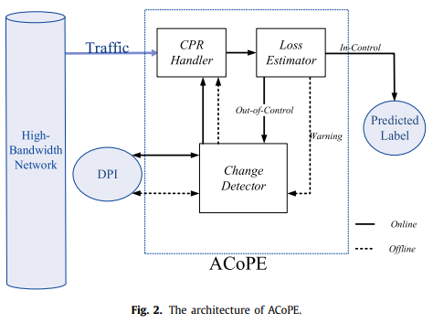
Architecture
ACoPE uses Interflow Relation and Semi-Supervised Machine Learning and uses DPI for verifying
Modules
DPI: Depp Packets Inspection using ML techniques
Adaptive Learning and Comprehensive Processing

Slide 5

Algorithm Workflow
${CPR}_{t}$={${MF}_{1}$, ${MF}_{2}$, ${MF}_{3}$,....}
${MF}_{i}$=(c,r,b,ts,ld,$σ_{i},ρ_{i}$)
New arriving flow f ➔ Corresponding MetaFlow ${MF}_{i}$ with label l’, DPI label l
if state(${MF}_{i}$,in_control)➔ add(${MF}_{i}$,f)
if state(${MF}_{i}$,warning) ➔ addlabel(${MF}_{i}$,l)
if state(${MF}_{i}$,out_of_control) ➔addNewMetaFlow ${MF}_{i}$’ with label l’ that consists of f, delete ${MF}_{i}$
Delete ${MF}_{i}$ if it has not entered any new flow

Slide 6
Evaluation
Testbed architecture and model
Datasets
Performance criterias:
accuracy, precision, recall and detected class count in VPN & TOR dataset in compare to other traffic stream classification algorithms.
CPU/RAM usage SessionCount/DroppedSessions in different administrator requirement scenarios includes: Heavy-loaded application, Modified-application scenarios, DDOS

Slide 7
Relation
Which component of our architecture? Tagger
Which problem it solve? Different application classification
Why to use it? Adaptive and Comprehensive Processing
Draw it in picture:

